Slide 1
BIBLIO CURIOUS
A terminal app of interminable duration

Slide 2
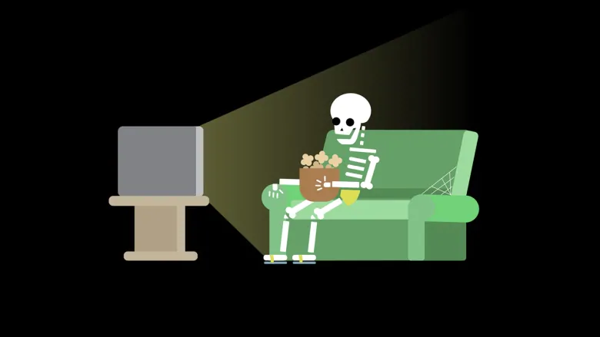


Slide 3

THIS IS AN IMAGE REPRESENTING A PARADOX

Slide 4

DO YOU DISLIKE IMAGES LIKE THIS AS MUCH AS ME?

Slide 5
Oh god please work!!!!1 🙏 🙏 🙏

Slide 6
